Slide 1

Technical Presentation Comparing Strong and Weak Entities in ER Modeling
CSA0508-DATABASE MANAGEMENT SYSTEMS
GUIDED BY :
DR.G.AYYAPPAN
Name: Y.Yogesh
Reg no.: 192525004
Department : AIML

Slide 2
INTRODUCTION
What is ER Modeling?
ER (Entity-Relationship) modeling is a technique used to design databases.
It represents data as entities, attributes, and relationships.
It helps developers understand how data is connected before creating database tables.
ER diagrams simplify database design and improve communication.

Slide 3
What is an Entity?
Definition
An entity is a real-world object, person, place, event, or concept whose information is stored in a database.
Examples
Student
Employee
Customer
Product
Hospital
Entity Representation
Drawn as a Rectangle in an ER diagram

Slide 4
Strong Entity
Definition
A Strong Entity is an entity that exists independently.
Characteristics
Has its own Primary Key
Does not depend on another entity
Can exist alone
Represented by a Single Rectangle
Example
Student
Student_ID (Primary Key)
Name
Department

Slide 5
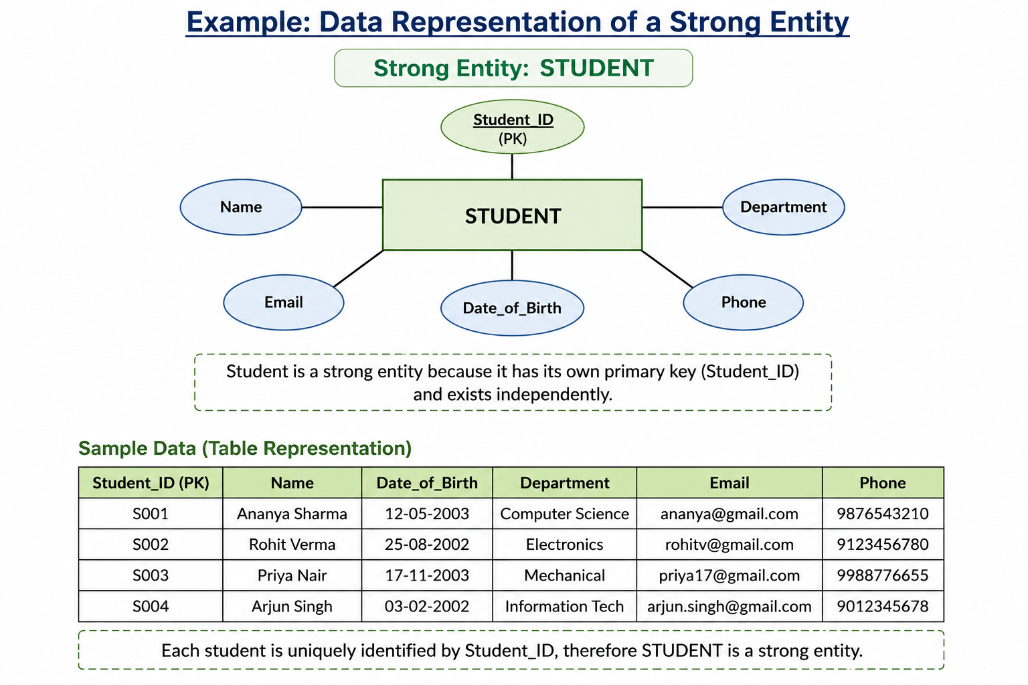

Slide 6
Weak Entity
Definition
A Weak Entity cannot exist without a related strong entity.
Characteristics
Has no complete primary key
Depends on a strong entity
Uses a Partial Key
Represented by a Double Rectangle
Example
Dependent
Dependent_Name (Partial Key)
Age
Depends on
Employee(Employee_ID)

Slide 7
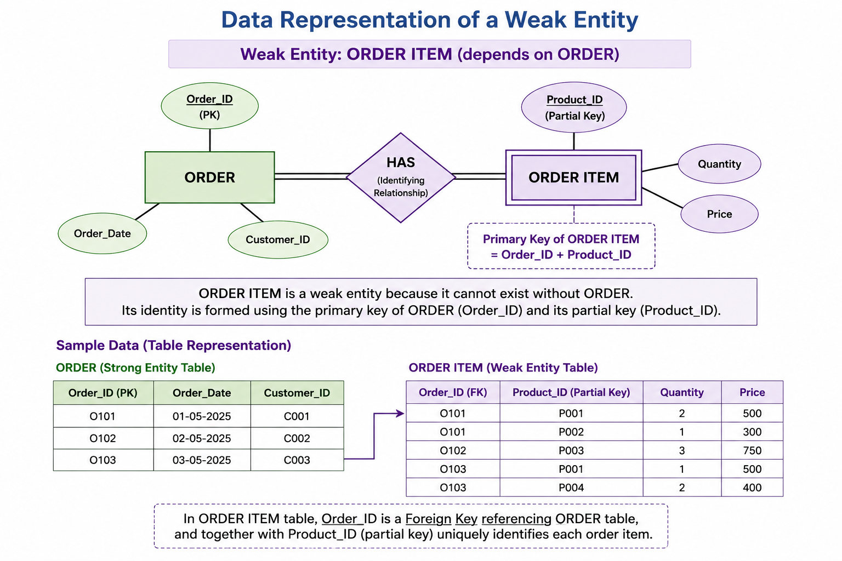

Slide 8
Comparison Between Strong and Weak Entity
Strong Entity | Weak Entity
Exists independently | Depends on strong entity
Own Primary Key | Partial Key
Single Rectangle | Double Rectangle
Optional participation | Total participation
Parent entity | Child entity

Slide 9
Real-World Example 1 – E-Commerce
Strong Entity
Order
Attributes
Order_ID
Date
Customer_ID
Weak Entity
Order Item
Attributes
Product_ID
Quantity
Order Item cannot exist without an Order.

Slide 10
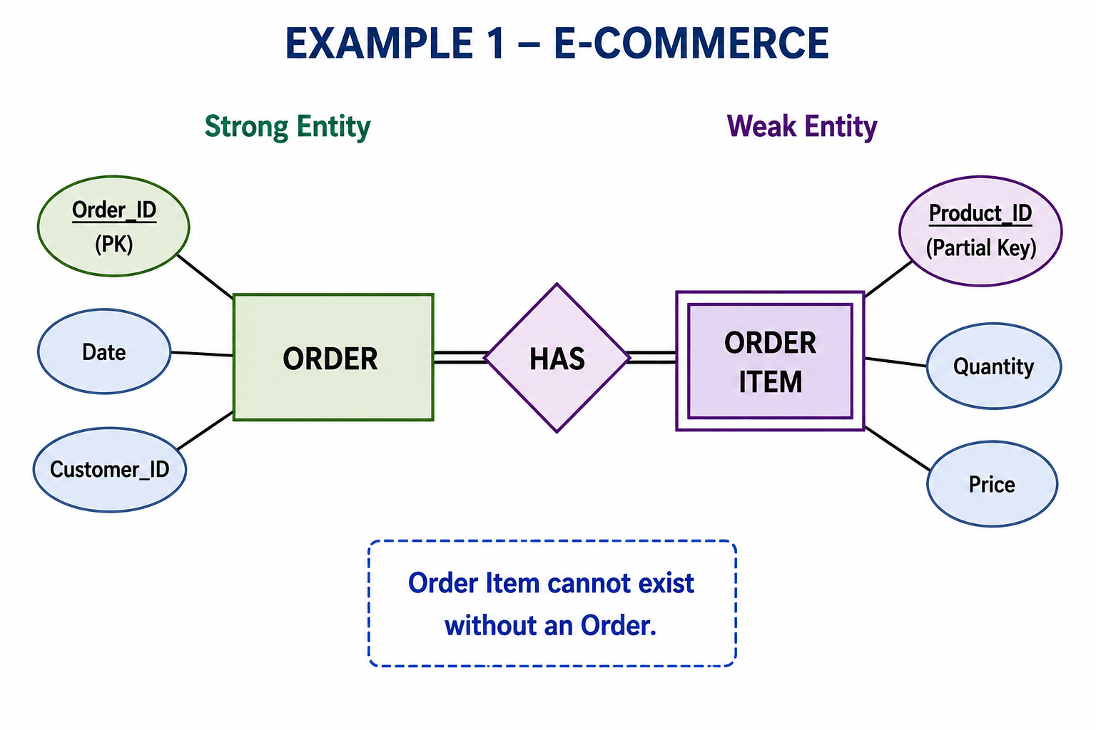

Slide 11
Real-World Example 4 – Hospital Management
Strong Entity
Patient
Attributes
Patient_ID
Name
Age
Weak Entity
Medical Visit Record
Attributes
Visit Date
Diagnosis
A visit record cannot exist without a patient.

Slide 12
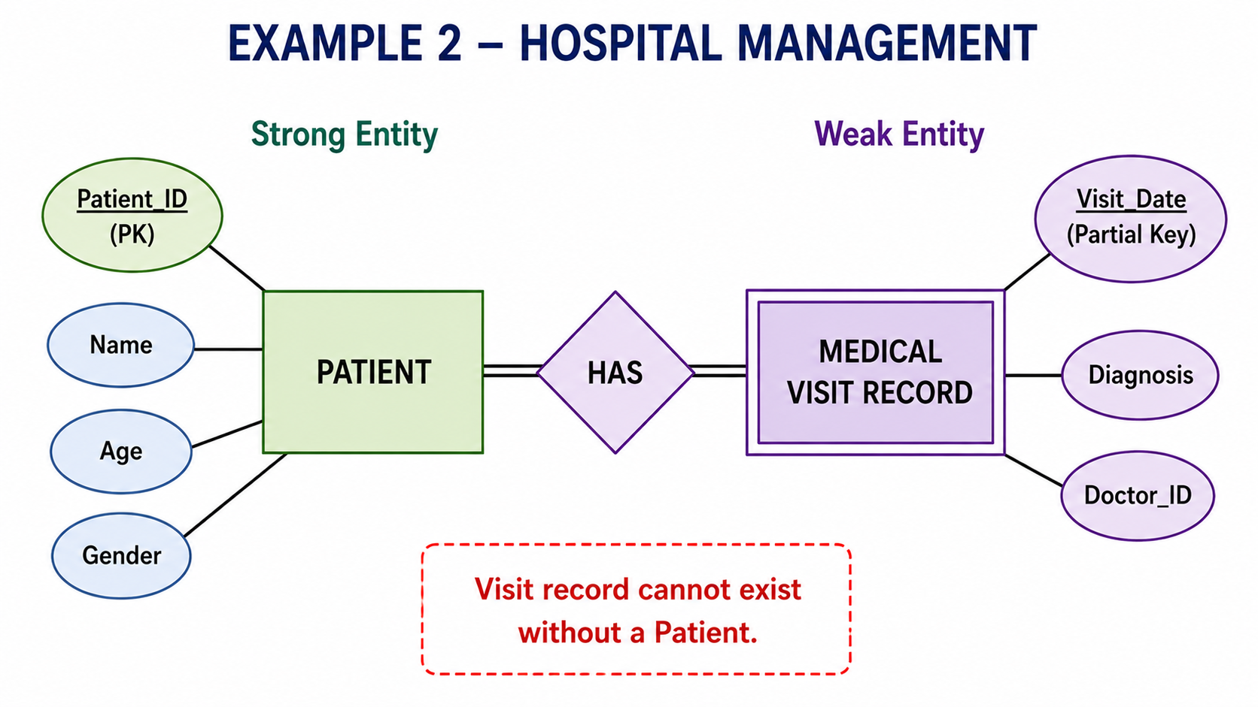

Slide 13
Advantages
Strong Entity
Easy to identify
Independent
Simple database design
Efficient searching
Weak Entity
Avoids duplicate data
Maintains dependency
Represents real-world relationships accurately
Improves database integrity

Slide 14
Limitations
Strong Entity
Cannot represent dependent objects
May create redundant information
Weak Entity
Complex implementation
Composite primary keys
Requires identifying relationship
Cannot exist independently

Slide 15
Best Practices
Use strong entities for independent objects.
Use weak entities only when dependency exists.
Always define a primary key for strong entities.
Use identifying relationships correctly.
Avoid unnecessary weak entities.
Follow normalization principles.

Slide 16
Summary Comparison
Feature | Strong Entity | Weak Entity
Independence | Yes | No
Primary Key | Own PK | Partial Key
Existence | Independent | Dependent
Representation | Single Rectangle | Double Rectangle
Participation | Partial | Total

Slide 17
Conclusion
Strong entities exist independently and possess their own primary keys.
Weak entities depend on strong entities for identification.
Identifying relationships connect strong and weak entities.
Choosing the correct entity type results in efficient and well-structured database design.
Understanding these concepts is essential for designing accurate ER diagrams and relational databases.

Slide 18


